Slide 1

Real Estate Property Transactions
Team - 02
SRUJANA GUGGILLA [1002165664]
MISBAHJABIN SHAIKH [1002189629]
JAINY BHATT [1002175002]
RAISA TASNIM [1002176260]

Slide 2

CONTENT
INTRODUCTION
UNDERSTANDING DATASET
DATA PREPROCESSING
EDA
UNIVARIATE ANALYSIS
BIVARIATE ANALYSIS
FOLIUM MAP
HEAT MAP
DASHBOARD (TABEULA )
MODELLING
CONCLUSION

Slide 3
INTRODUCTION
Researchers, analysts, and stakeholders in the real estate sector can utilize this dataset to understand market dynamics, assess property values, and make informed investment decisions.
We'll dive into the trends, challenges, and opportunities shaping the real estate landscape today and in the future.

Slide 4
PROBLEM STATEMENT
The primary objective of this project is to develop a predictive model that can accurately forecast real estate sales prices based on a comprehensive set of predictors.
By leveraging advanced analytics techniques and machine learning algorithms, the model aims to provide actionable insights to stakeholders, enabling them to make informed decisions and optimize their real estate transactions.

Slide 5
UNDERSTANDING THE DATA SET
Data has 12 attributes and 1000 entries.
Collected data contains integer, object and float-type data values.
Column Names :
Date
Year
Locality
Estimated Price
Sales Price
Property
Residential
Num_rooms
Num_bathrooms
Carpet_area
Property_rate_tax
Face

Slide 6

Locality : 7 Cities
Waterbury, Norwalk, Bridgeport, Greenwich, Fairfield, West Hartford, Stamford
Property: 4 types
Single Family, Two Family, Three Family, Four Family
Residential: 4 types
Detached House, Duplex, Triplex, Fourplex
Face: 4 types
North, South, East, West
‹#›

Slide 7
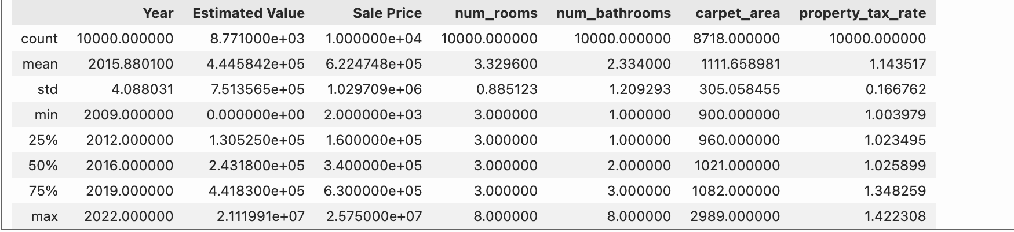
DATA DESCRIPTION

Slide 8
DATA PRE-PROCESSING
1. Dropped Column “Date”
As the dataset has a 10 years of instances, we dropped the column”date”
2. Checked for Duplicate Values
3. Checked for the unique values
No duplicates
checked value counts of the unique values of “Property”.
1788 “?” values are replaced with NaN(value mapping)
4. Used Iterative Imputation
Observed the missing value percentage, fileterd numerical columns, imputed and fitted in the columns to transform
5. Standardization
To bring features into similar scales, standardized the numerical columns to bring mean of 0 and standard deviation of 1

Slide 9
Data Preparation
6. Checked missing values for Categorical Column
Looked into missing value percentage and columns having missing values exceeding 0
7. Random Sampling Method
Replaced the missing values by using random sampling based on the category of the dataset
8. Removed Duplicate Rows
Concatenated both numerical and categorical values and removed row #9878
9. One Hot Encoding
Splitted numerical and categorical columns once again, used one hot encoding that created dummy variables for each categoricals, and dropped the first level to avoid multicollinearity.
10. Dataset is all set !
Dataset is ready for modelling

Slide 10
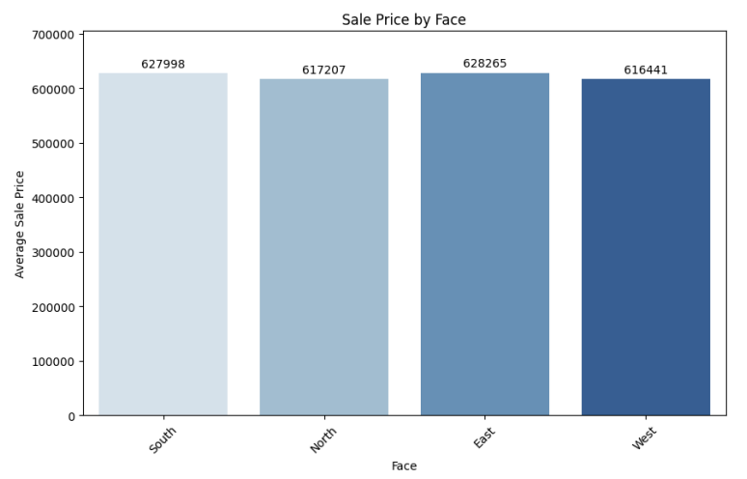
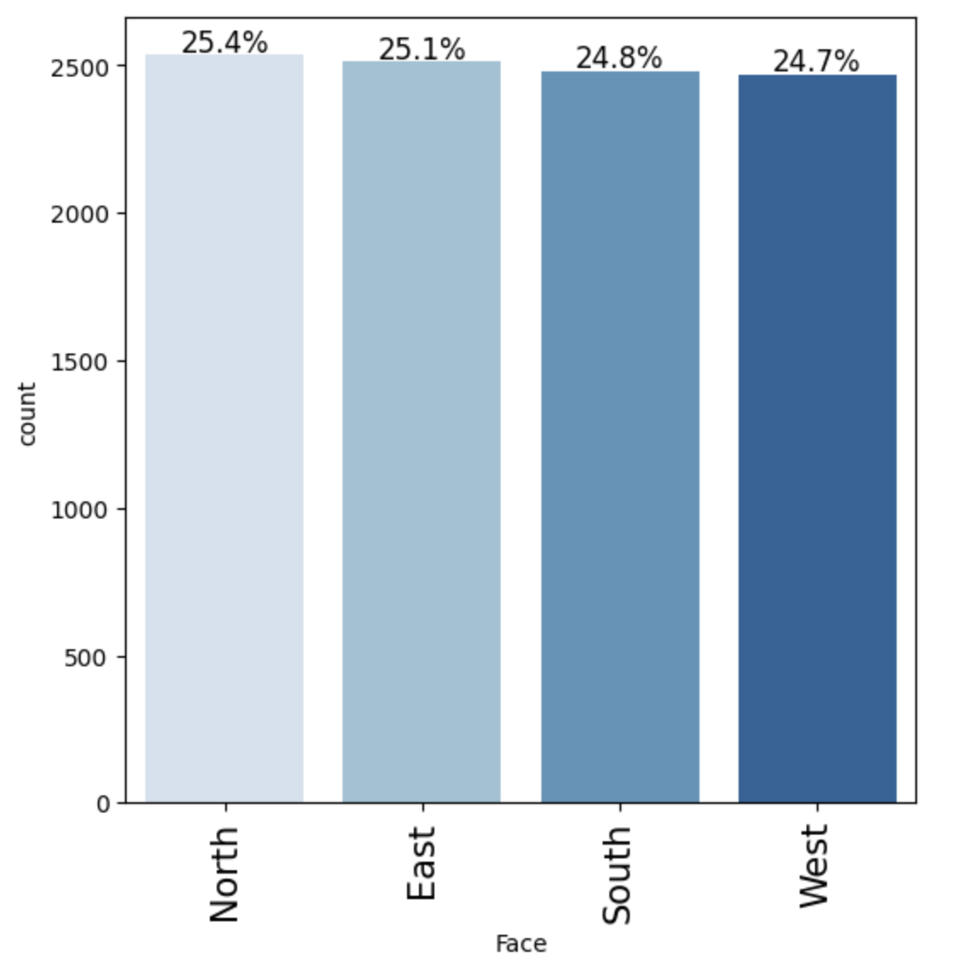
Data Visualization
EDA
Number of all facing houses are almost even
South and East Facing houses are having higher sale prices

Slide 11
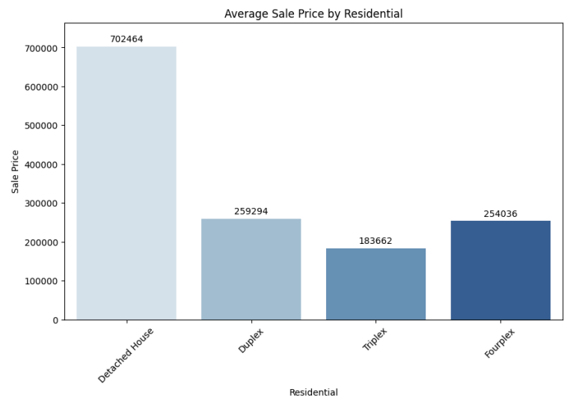
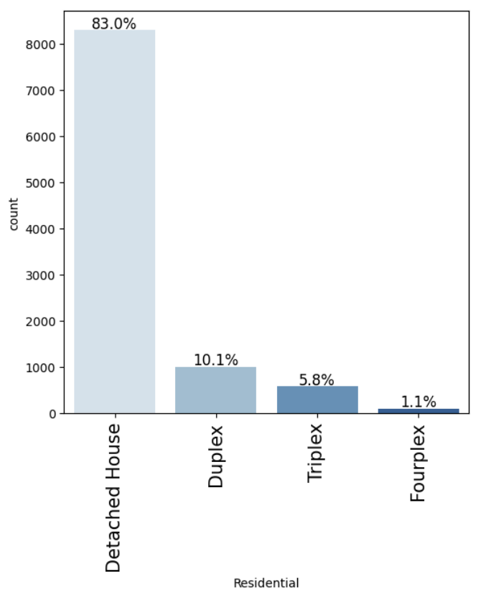
Data Visualization
Demand for Detached houses are higher
Sale Prices for Detached Houses are the highest, Fourples and duplex are observed slightly different

Slide 12
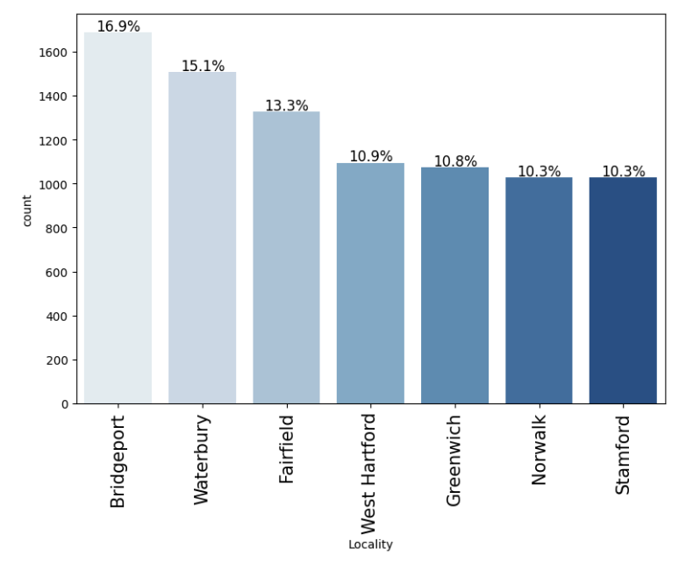
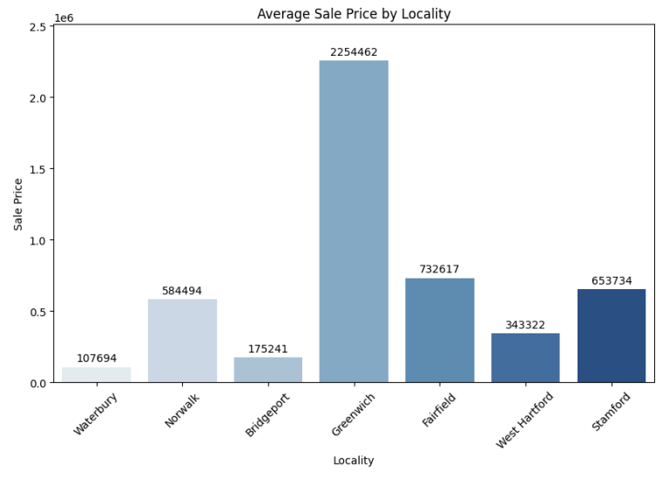
Analyzing Pattern for the Average Sale prices
Bridgeport has the highest number of Properties
Sales price is the highest in Greenwich and lowest for Waterbury and Bridgeport

Slide 13
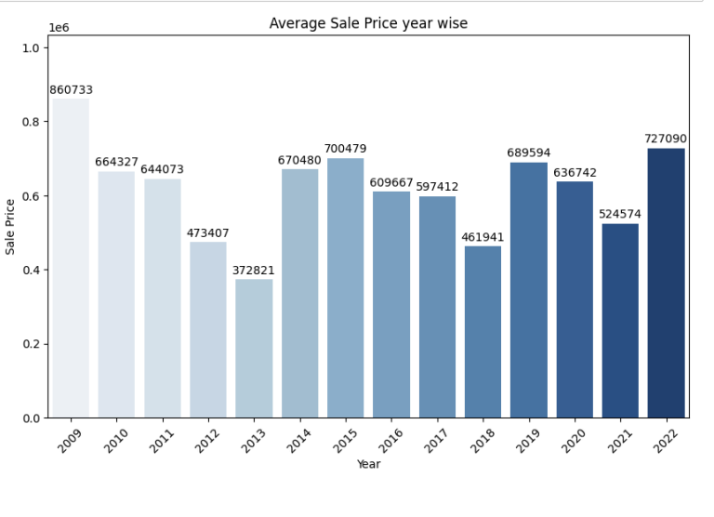
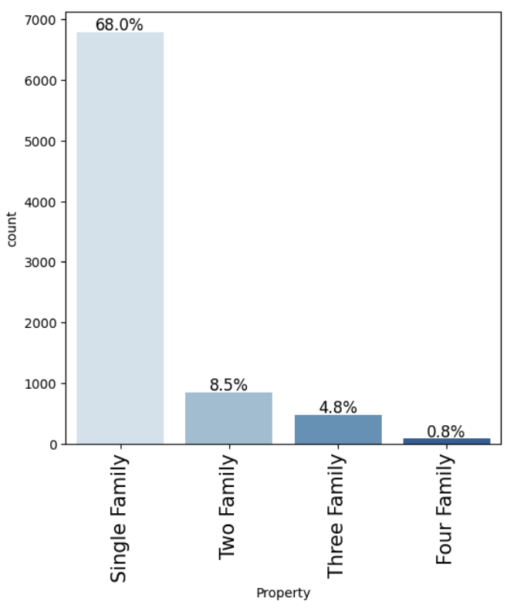
Analyzing Pattern for the Average Sale prices
2009 experienced a highest peak and dropped until 2013, however a rise started from 2014 and again the pattern dropped in 2018
Higher trends in having Single-family household

Slide 14
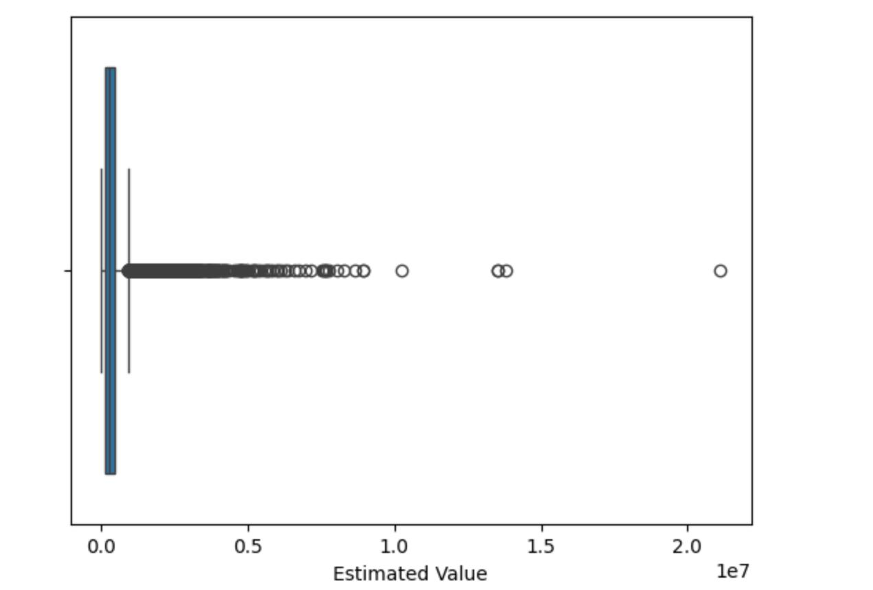
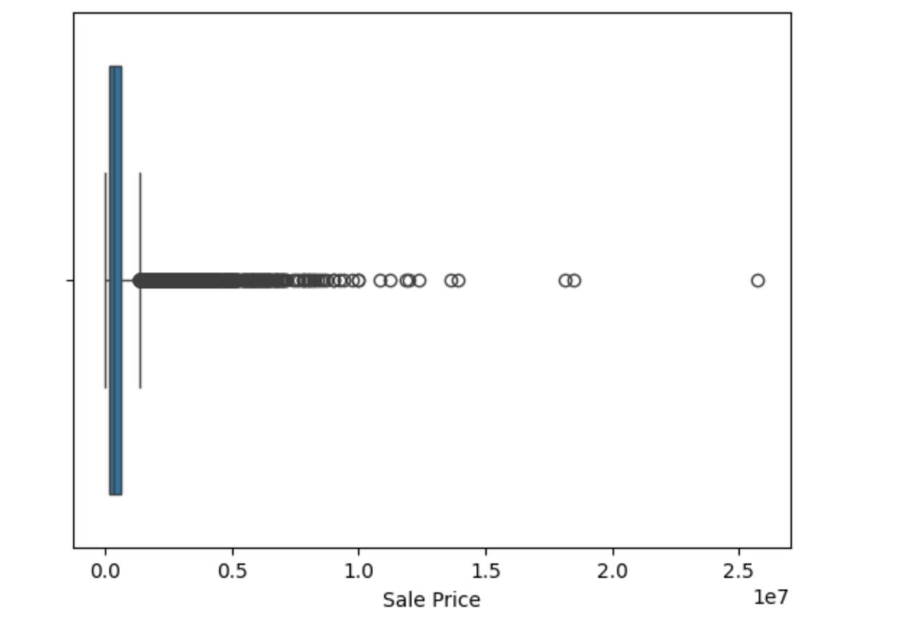
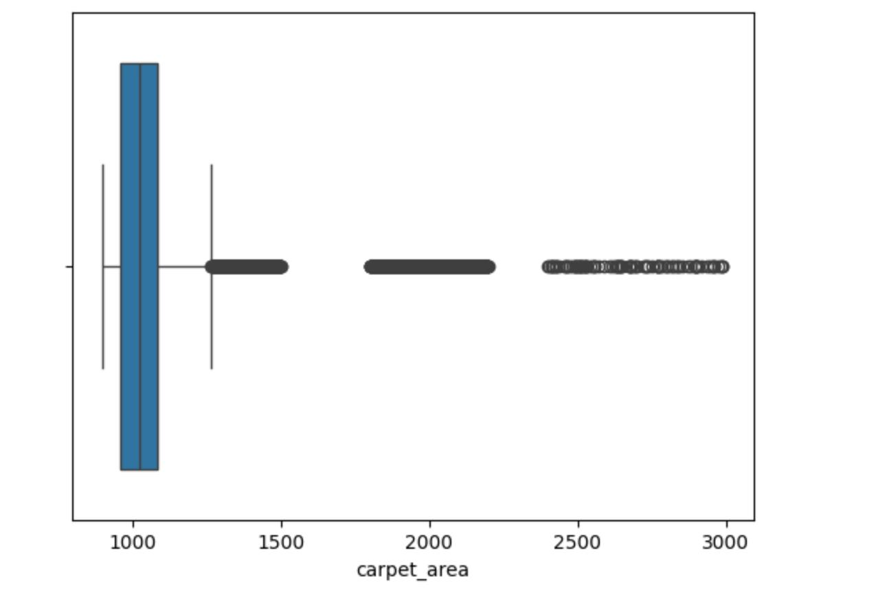
Box-Plot for Outliers

Slide 15
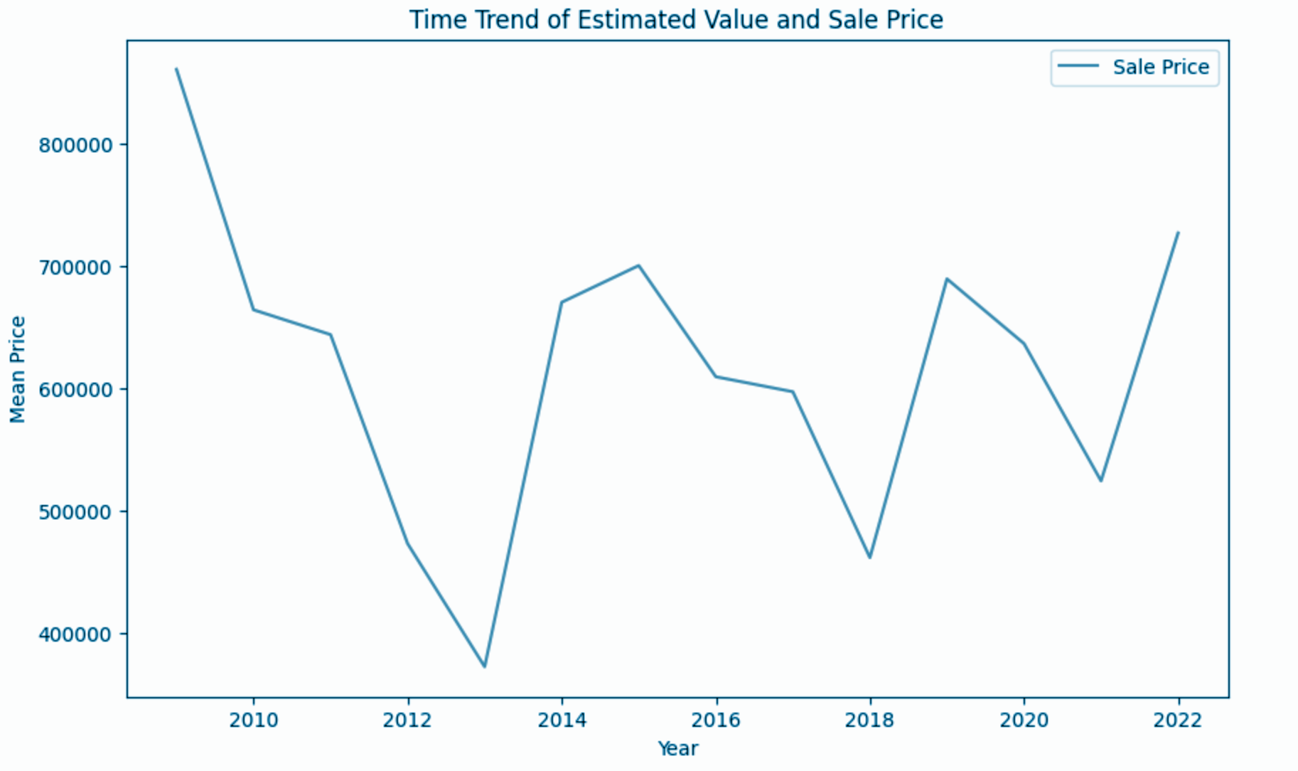
Overview on Sales Price Pattern
A Trend of Sale Price within a Decade
Peak before 2010
Highest Drop in 2013

Slide 16
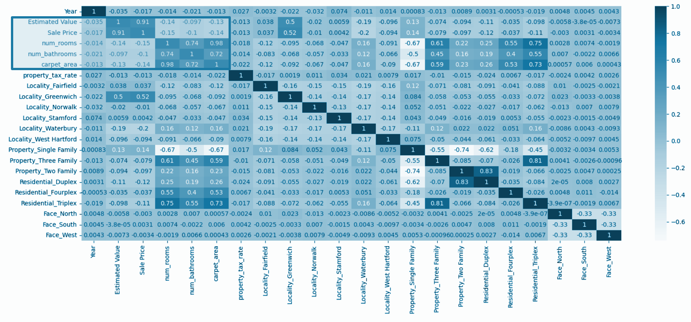
Correlation Heatmap
HEAT MAP
And still going strong!

Slide 17
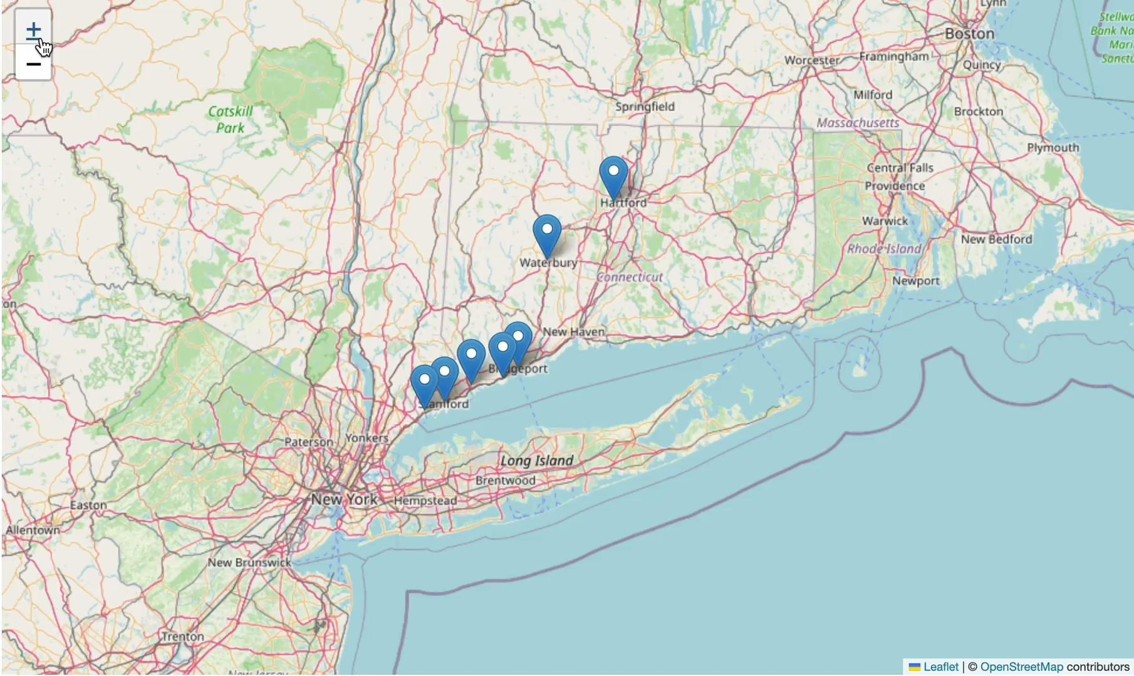
Geographical Analysis
FOLIUM MAP

Slide 18
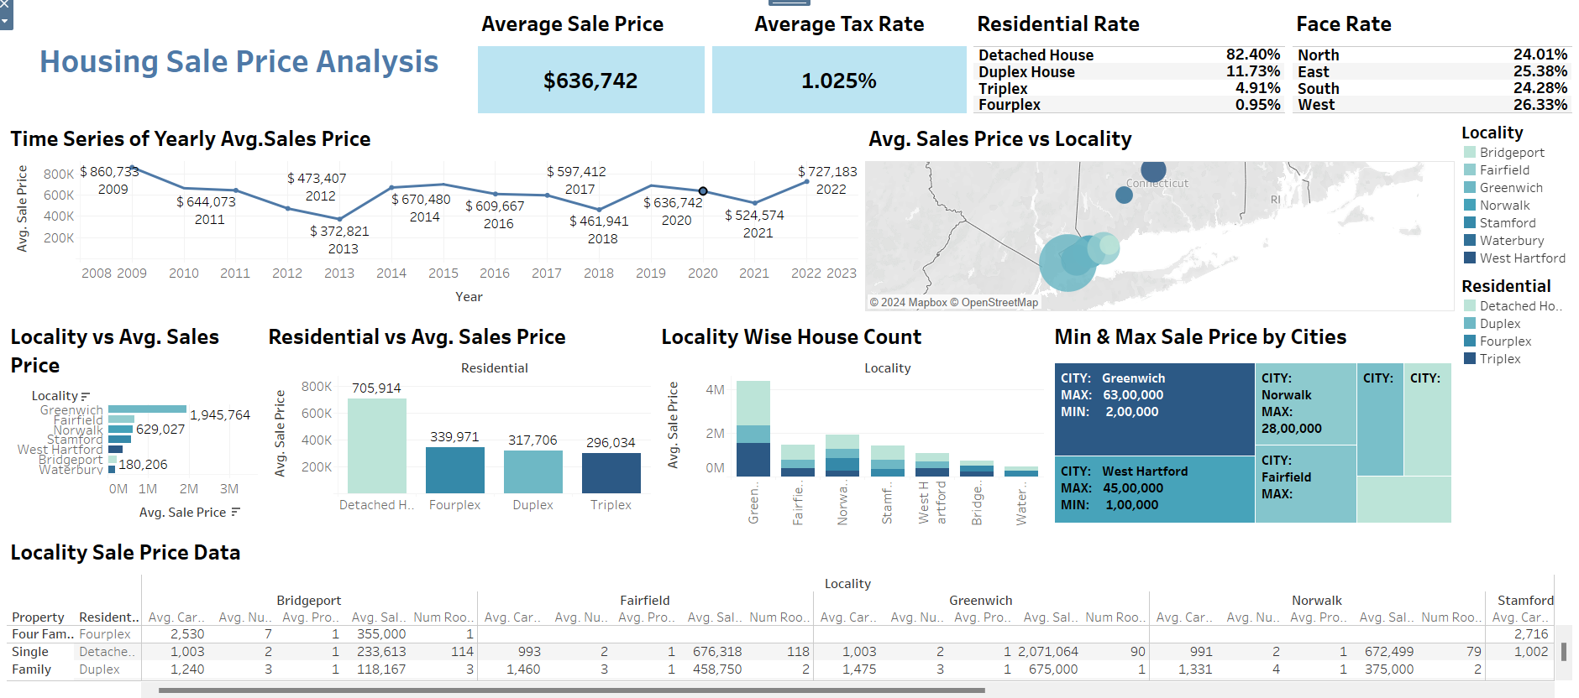
A Quick Visualization in Dashboard

Slide 19
MODEL BUILDING
ADA Boost
Hyper Tuning
 | RMSE | MAE | R-squared | Adj-R-squared
Training | 0.928646 | 0.522891 | 0.089948 | 0.087781
Testing | 1.060856 | 0.534028 | 0.069427 | 0.060497
 | RMSE | MAE | R-squared | Adj-R-squared
Training | 0.804685 | 0.381182 | 0.316689 | 0.315062
Testing | 0.919739 | 0.393122 | 0.300534 | 0.293822
Jupiter is a gas giant and the biggest planet in our Solar System
OPPORTUNITIES
THREATS

Slide 20
XGBoost
Hyper Tuning
 | RMSE | MAE | R-squared | Adj-R-squared
Training | 0.382172 | 0.209492 | 0.845871 | 0.845504
Testing | 1.029149 | 0.426974 | 0.124222 | 0.115818
 | RMSE | MAE | R-squared | Adj-R-squared
Training | 0.772372 | 0.350903 | 0.370466 | 0.368967
Testing | 0.92017 | 0.374877 | 0.299879 | 0.293161
Jupiter is a gas giant and the biggest planet in our Solar System
OPPORTUNITIES
THREATS

Slide 21
Random Forest
Hyper Tuning
 | RMSE | MAE | R-squared | Adj-R-squared
Training | 0.319636 | 0.145653 | 0.892186 | 0.891929
Testing | 1.004555 | 0.4183 | 0.16558 | 0.157573
 | RMSE | MAE | R-squared | Adj-R-squared
Training | 0.786139 | 0.355414 | 0.347825 | 0.346272
Testing | 0.921023 | 0.374307 | 0.29858 | 0.291849
Jupiter is a gas giant and the biggest planet in our Solar System
OPPORTUNITIES
THREATS

Slide 22
RIDGE
LASSO
 | RMSE | MAE | R-squared | Adj-R-squared
Training | 0.806044 | 0.366705 | 0.314379 | 0.312747
Testing | 0.928903 | 0.380265 | 0.286527 | 0.27968
 | RMSE | MAE | R-squared | Adj-R-squared
Training | 0.806375 | 0.36597 | 0.313817 | 0.312183
Testing | 0.928971 | 0.379113 | 0.286421 | 0.279573
Jupiter is a gas giant and the biggest planet in our Solar System
OPPORTUNITIES
THREATS

Slide 23
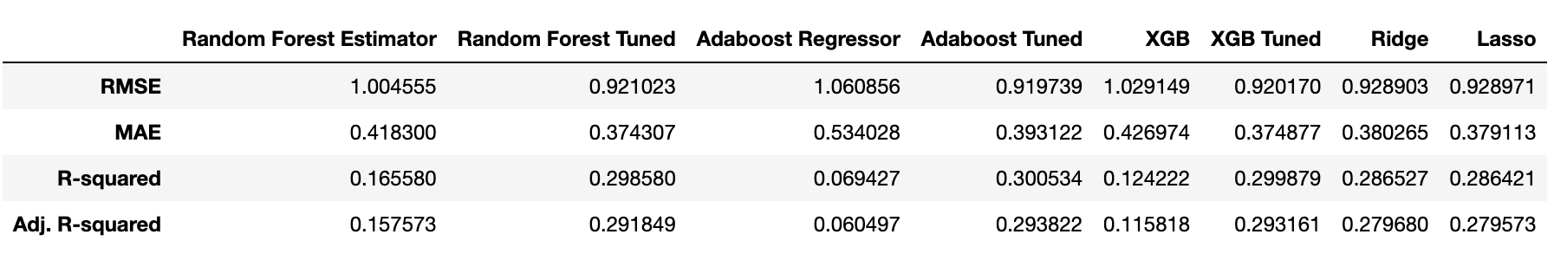
COMPARISON - TESTING RESULTS
Comparison- Testing Results

Slide 24
CONCLUSION
By comparing all the models, we can conclude that most of the models are showing the overfitting except the Ridge and Lasso are the best model that best predicts sale price
The result of the Training and test RMSE and R2 are very close for both Ridge and Lasso.
Although there is still a lot of improvement required for more accurate result.

Slide 25


